Slide 1
Weather Forecast Application using spring boot project

Slide 2
Project Details
Spring Boot version – 3.1.4
Java version – java 17
Data Base – H2 database

Slide 3
This project involves fetching weather data from the OpenWeather API based on the user's provided location name. If a user fetches data multiple times for the same location without making a direct connection to the OpenWeather API, the data will be stored in our database. Subsequently, when users request weather information for that location, the application will retrieve the stored data from the database and display it to the users.

Slide 4
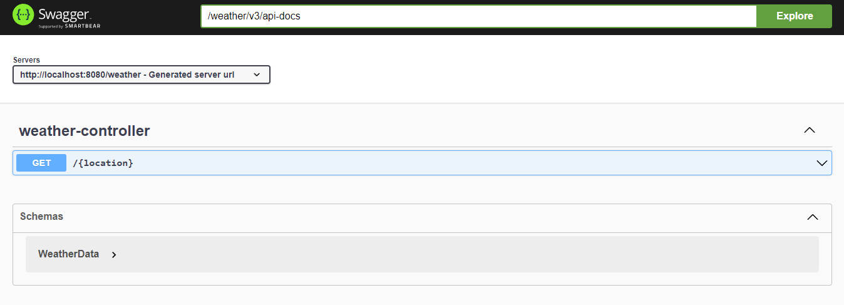
API Details (Swagger)

Slide 5
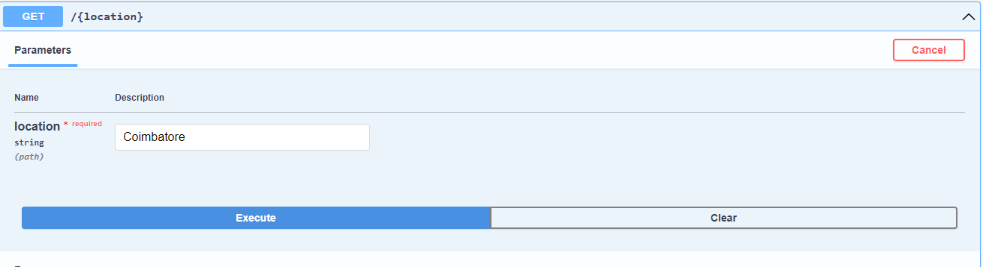
GET REQUEST (Weather)

Slide 6
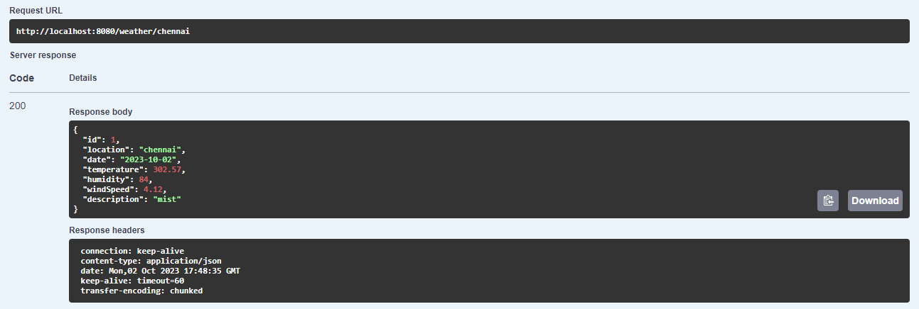
SUCCESS RESPONSE

Slide 7
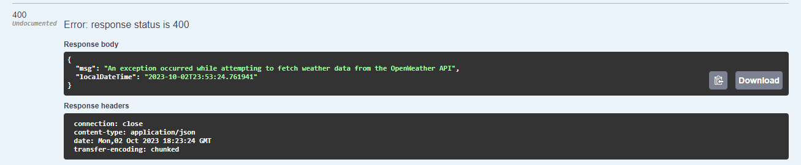
FAILURE RESPONSE

Slide 8
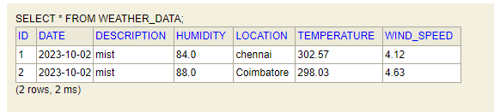
SAMPLE RECORD IN DB

Slide 9
Project Setup Configuration
Java 17 Minimum requirement for running this project.
In database H2 database configured in application level
User Name – user
Password – password
Note: ddl enabled in application properties file so no need to create database and table.

Slide 10
Other Details
Swagger URL - http://localhost:8080/weather/swagger-ui/index.html
Database URL - http://localhost:8080/weather/h2-console/

Slide 11
Thank you

